Slide 1
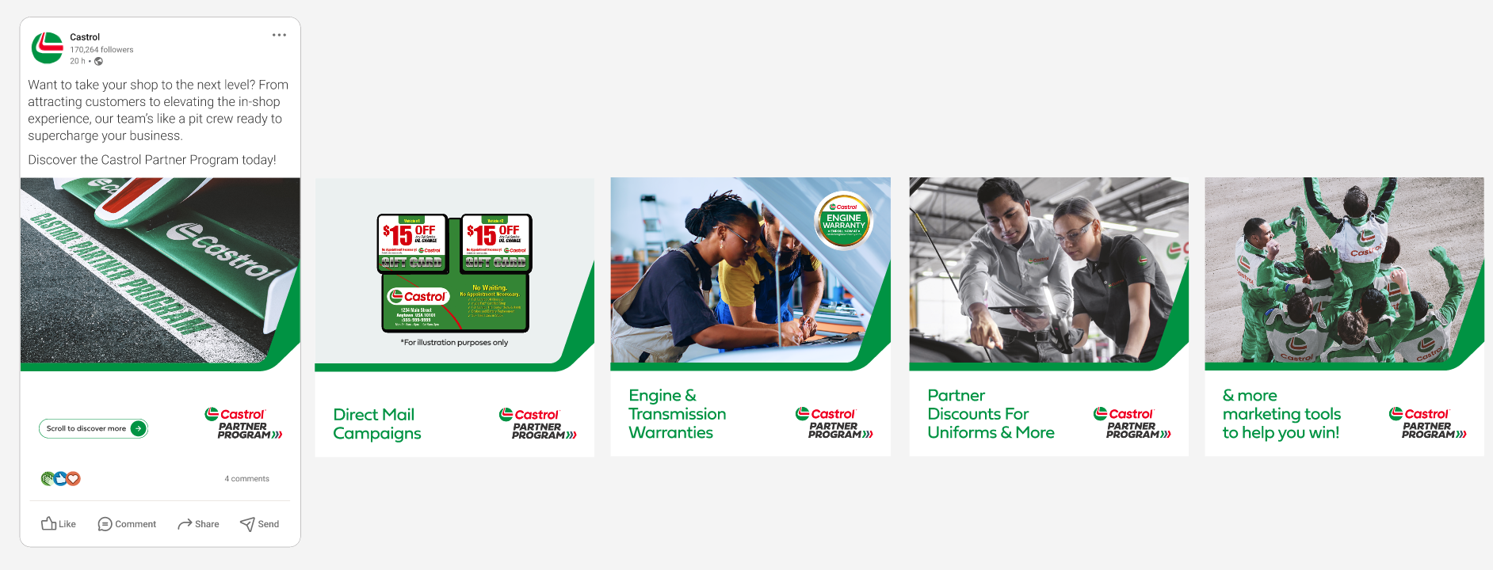
Castrol Partner Program content for LinkedIn/Facebook/Insta – Carousel 1
Copy:
Want to take your shop to the next level? From attracting customers to elevating the in-shop experience, our team’s like a pit crew ready to supercharge your business.
Discover the Castrol Partner Program today: Castrol Partner Program | Castrol® USA

